Slide 1
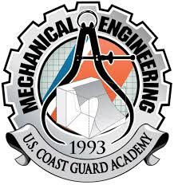

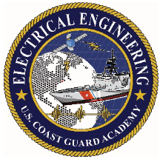
Autonomous Surface Vessel
1/c Ryan Barlow, 1/c Patrick Raymond, 1/c Connor Glynn, 1/c Samuel Kim, 1/c Wilson Moorer, 1/c Chanbopich Tann
Advisors: LT Ledzian and Dr. Reza
05 October 2021
Notes:
Connor

Slide 2
Project Introduction
Project started in Fall of 2018
Current Hull Design is the third version
Initial software was Arduino/MATLAB
RoboBoat Competition
Apply knowledge to build and code an ASV for submission to the yearly international competition.
Strives to innovate and advance robotics within the maritime industry.
Potential Uses in the Coast Guard
Search and Rescue (SAR)
Ports, Waterways and Coastal Security (PWCS)
Vessel inspections
Autonomy
Goal is full autonomous capability
Notes:
Connor

Slide 3
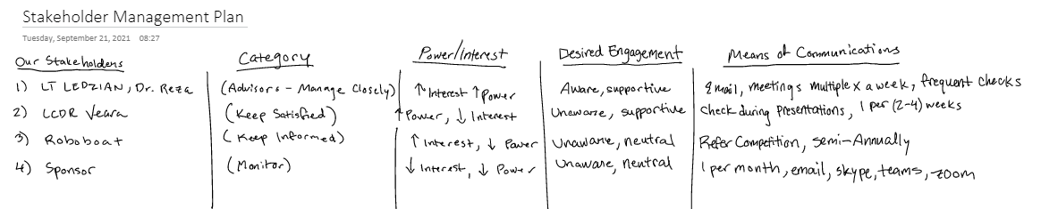
Stakeholders
LT Ledzian and Dr. Reza: Advisors who help manage the groups' activities and resources.
LCDR Veara: High Power, Low Interest who is provided with progress check ups
RoboBoat Judges: Need to meet their requirements for competition.
We currently have no sponsor
Notes:
Wilson

Slide 4
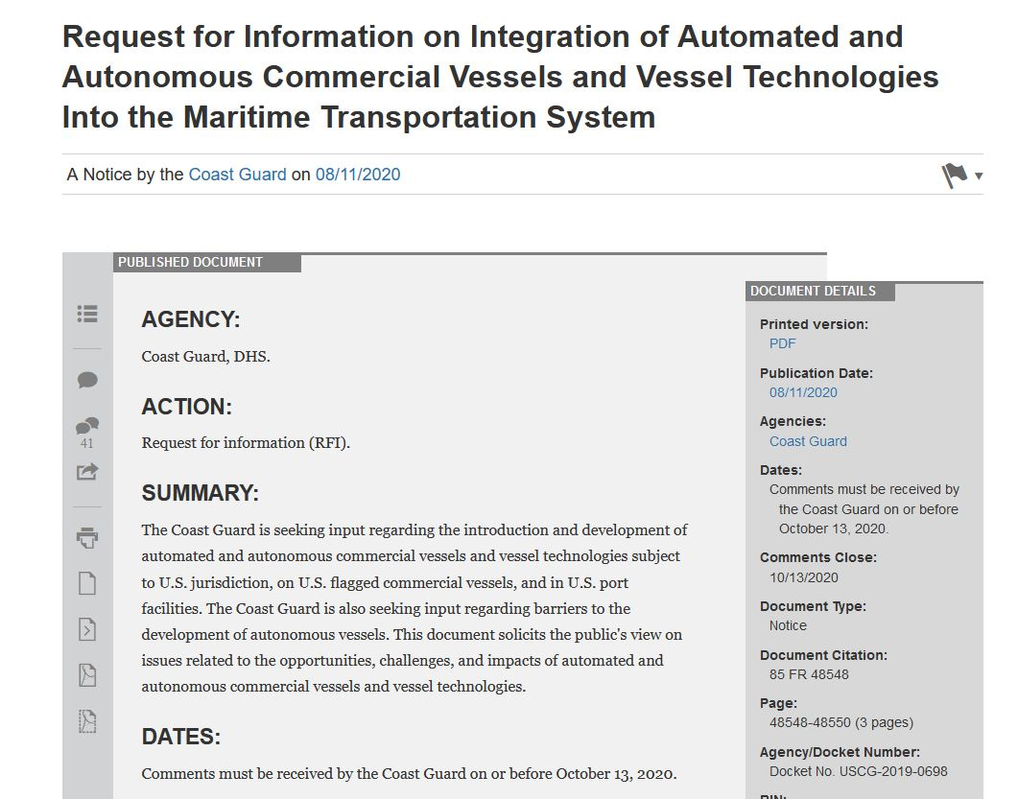
Project Benefit to the Coast Guard
The Coast Guard has expressed interest in development of autonomous vessels, soliciting feedback from the maritime domain and conducting initial semi-autonomous testing onboard a Coast Guard 29' RB-SII.
Offers the potential of using autonomous vessels for Search and Rescue, Port/Coastal Security, and combatting drug-trafficking
Notes:
Ryan

Slide 5
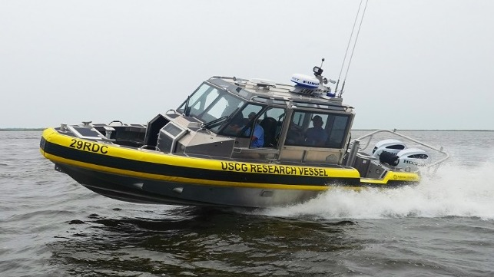
Coast Guard Mission Needs
Transit Autonomy
Active Ride Control and Course-Keeping
Collision Avoidance
Remote Vessel Monitoring
Detect object in the water and navigate accordingly
Notes:
Pat

Slide 6
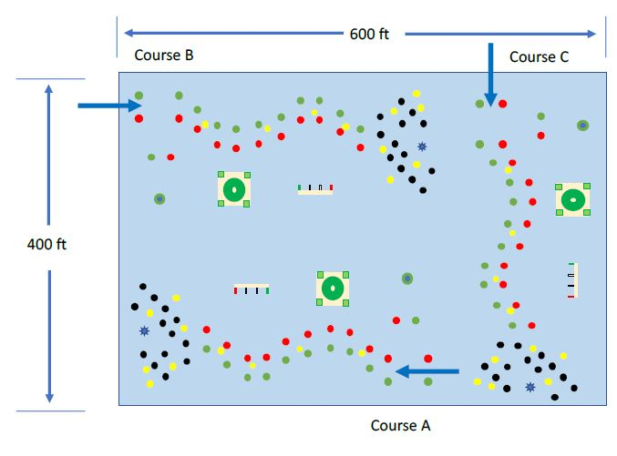
RoboBoat Competition
Mimic real operational tasks
Six course types:
Navigation Channel
Obstacle Channel
Obstacle Field
Acoustic Docking
Payload Delivery (UAV)
Speed Gate
Notes:
Sam

Slide 7
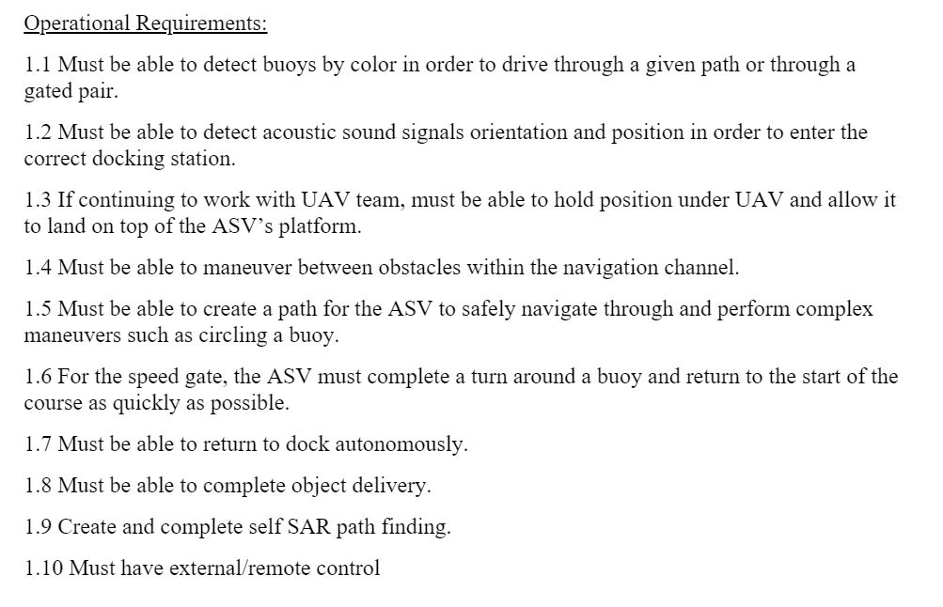
Project Requirements
RoboBoat Restrictions
Must be <140lbs and smaller than 6 ft x 3 ft x 3 ft
Notes:
Wilson

Slide 8
Carry-Over from Last Year
Kept majority of the hardware on the boat
Computer, thrusters, batteries, vessel itself, sensors
Decided to keep the UDOO bolt V8 computer already onboard
Allows to have a full OS on board
Allows us to skip the extended PR Process
Currently have 3 on hand
Kept the electronics box in the boat from last year as it does well in keeping water away from the electronics used
Notes:
Wilson

Slide 9
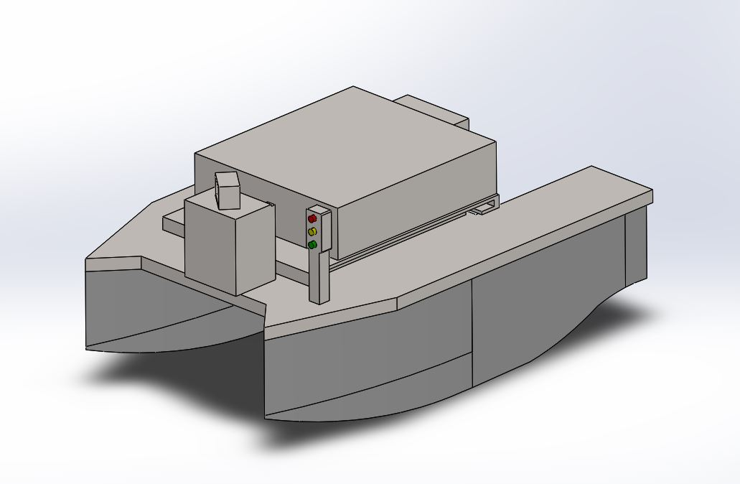
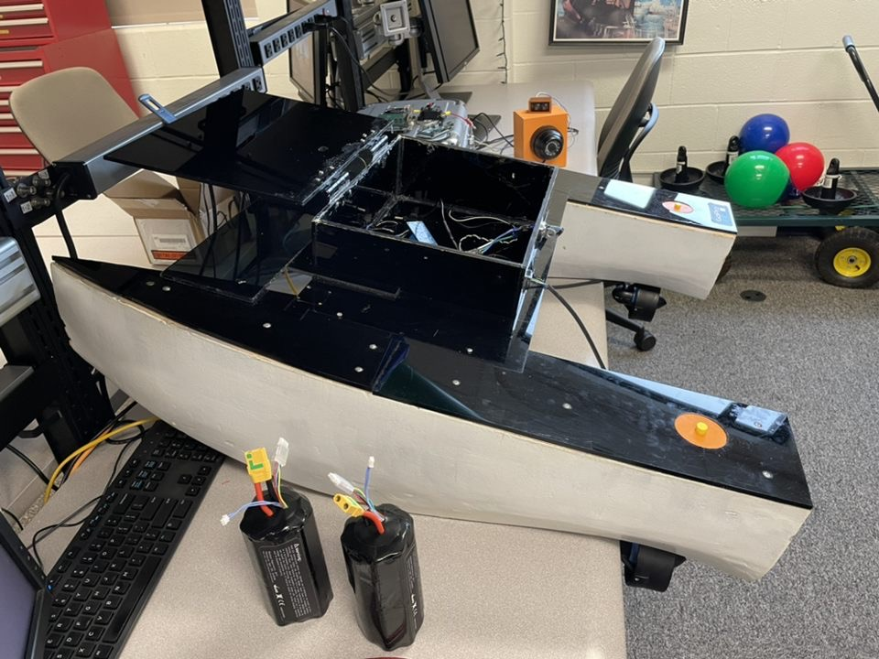
Our Current Vessel
Notes:
Ryan

Slide 10
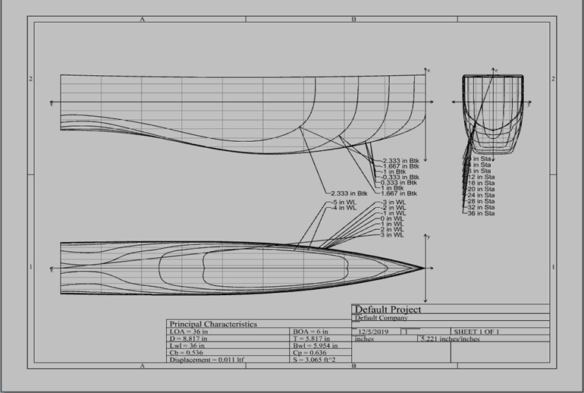
Vessel Design
Catamaran Style Vessel – Twin Hulls
Maneuvers via two thruster pods
Onboard Computer is a UDOO Bolt: interfaces with the Camera, LiDAR Sensor, 9 Degree-of-Freedom Inertial Measurement Unit (IMU), and GPS Module
Capability to be controlled remotely (RoboBoat Requirement)
Notes:
Ryan

Slide 11
Current Status
Controls and Model Team
Develop model that can give us a representation of how our vessel will act in the water
Create a controller that will steer the vessel based off a desired heading
Test different scenarios on how our vessel will respond with different inputs
Sensor Team
Testing Camera and LiDAR sensors for reliability and data output in different environments (direct sunlight, shade, cloudy skies, etc.)
Selecting the best sensor choices based on our group's approach to the RoboBoat Competition tasks.
Designing and modeling our methods of sensor attachment to the ASV and future landing platform for the UAV.
Computing Team
State diagram and state transitions
Find a heading from a GPS receiver to be used as an input for the controller
Troubleshoot and rewrite image detection code
Connecting sensors to the main computer
Understanding power distribution and circuitry with thrusters
Notes:
Tann

Slide 12
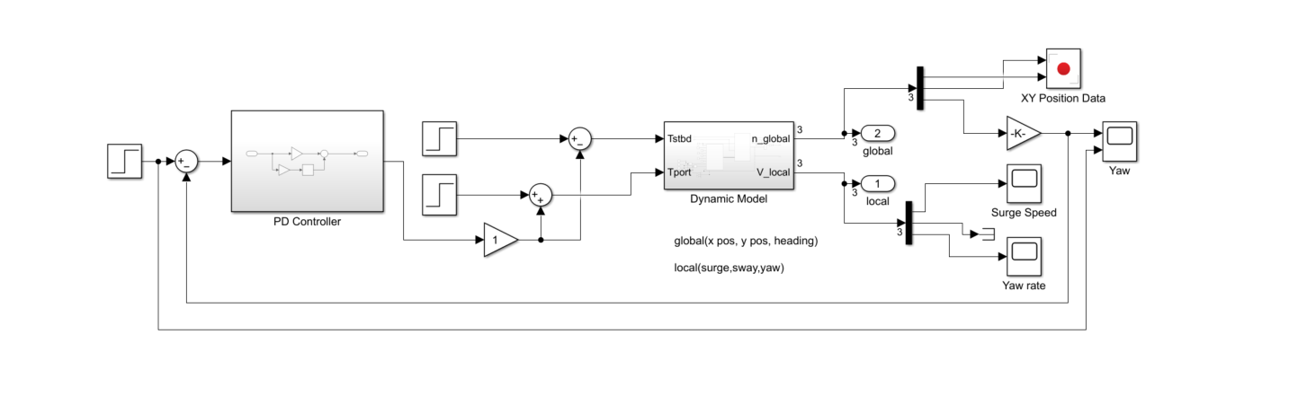
Modeling
Built in Simulink
3 Degree of Freedom model
Surge, Sway, Yaw
X-Y Position
Factors in thrust and physical properties to model movement in open water
Interfaces with controller to provide heading correction
Notes:
Connor

Slide 13

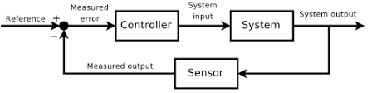
Controller
Started simple with a PD controller
Test the controller in the model to follow a desired heading
Apply to vessel and test in water
In the future, develop a controller that can track a state vector of multiple states.
Notes:
Pat

Slide 14
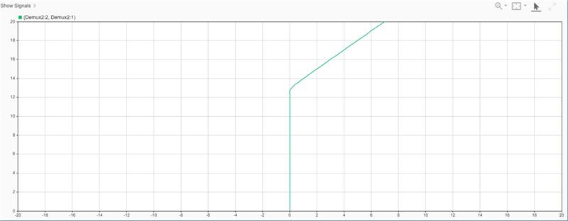
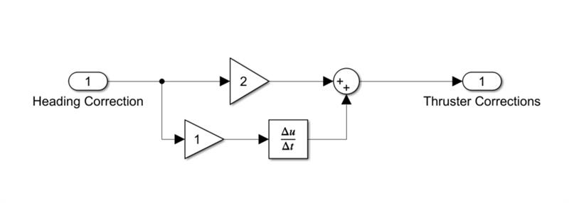
PD Controller
Used input of a 45-degree heading change
Controller holds steady on course
The input is the difference between the desired heading and the current heading
The output is the change in the port and starboard thruster value
Notes:
Pat

Slide 15
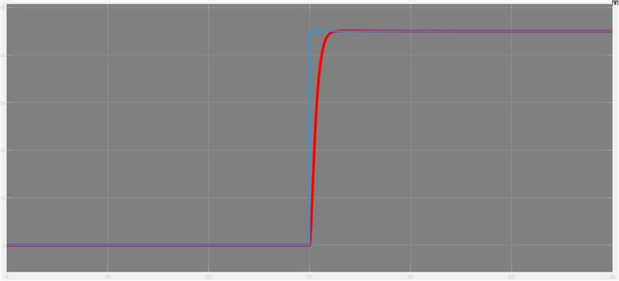
Controller Performance
Almost no overshoot (.22% overshoot)
Rise time of 2.6 seconds
Notes:
Pat

Slide 16
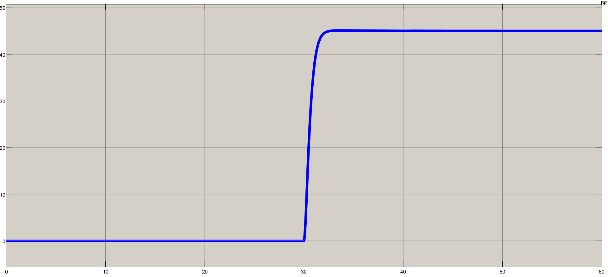
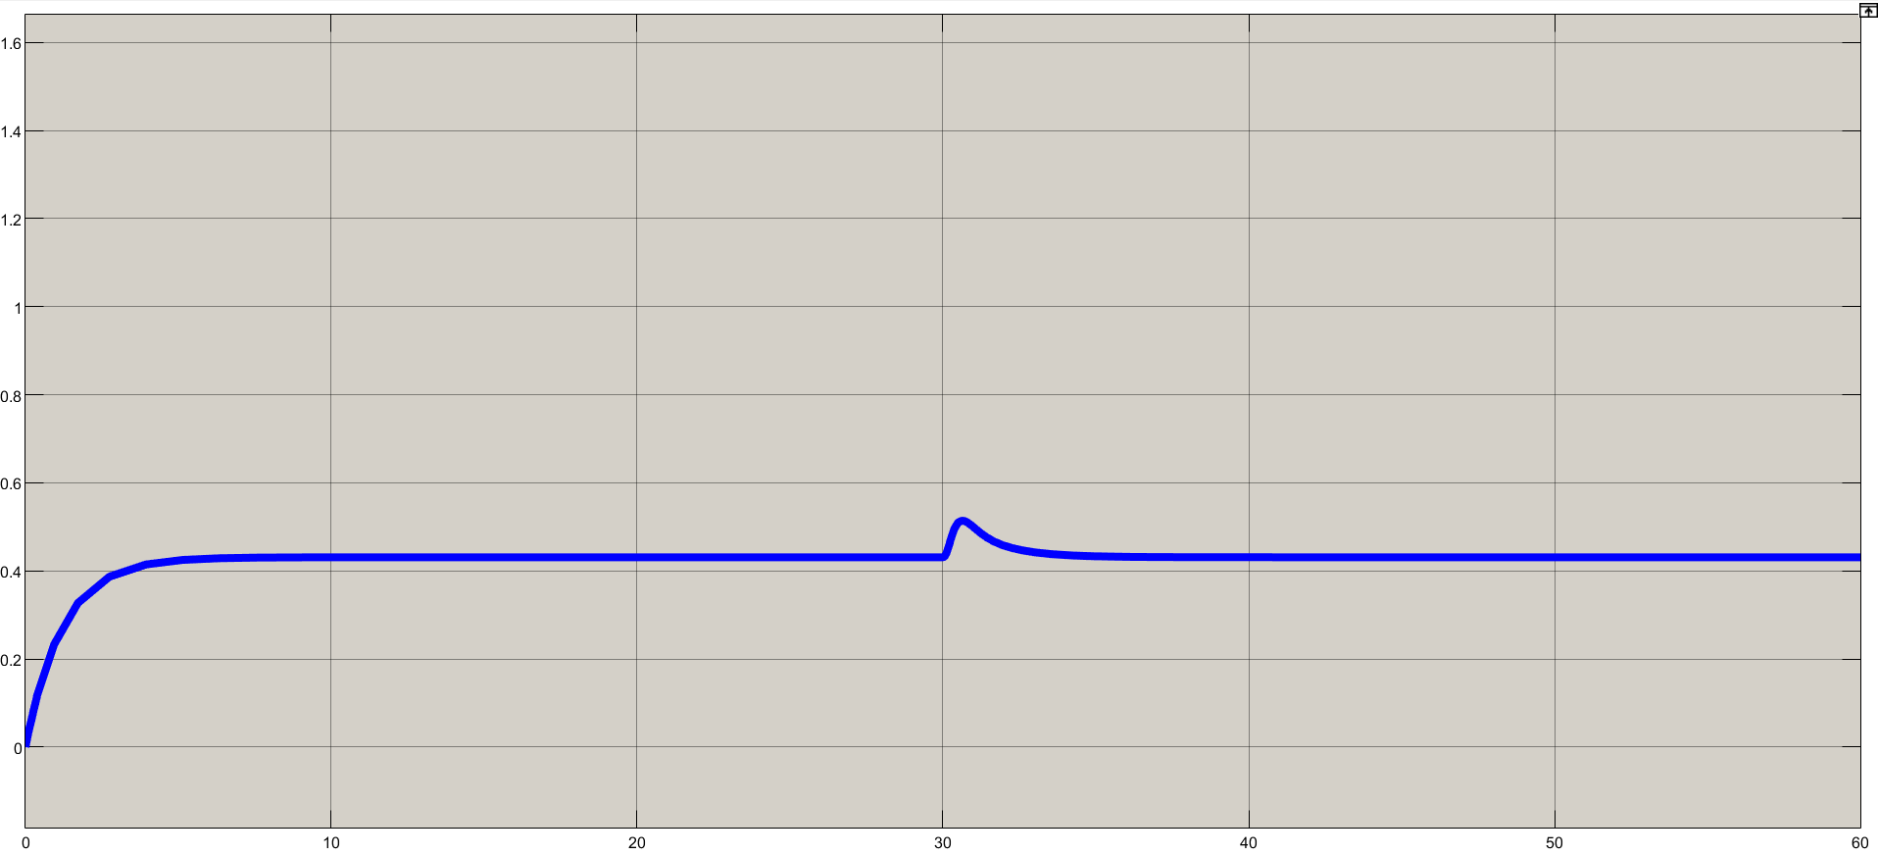
Model Converges to Steady Values
Yaw
Surge Speed
Notes:
Connor

Slide 17
Max RMS Error: 15%
Notes:
Connor

Slide 18
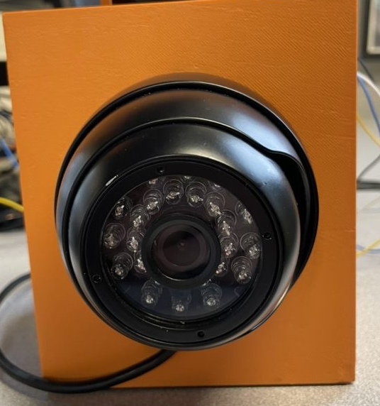
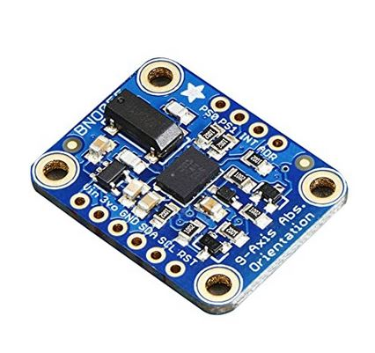
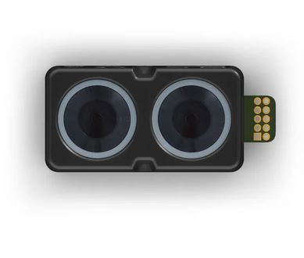
Sensor and Data Inputs
Image Detection – ELP Dome Camera (30FPS - 1MP)
Using a camera to detect size and shape of objects in the course.
This will help with directing the ASV away from obstacles and detecting the correct path to follow in the obstacle field.
9 DOF Adrafruit IMU - BNO055
Provides orientation, angular velocity, acceleration, linear acceleration, etc.
IMU will be the main data input into ASV controller
Will aid the ASV in maintaining steady course, speed, and movement
Range Detection – LiDAR Sensor
Using a Garmin Lidar Light Version 4.
Measures the distance from the vessel to surrounding objects in a 2D plane and will provide data input for "lane-keeping" as the ASV navigates the obstacle channel and obstacle course.
Notes:
Ryan

Slide 19
Sensor and Data Inputs
Location – Adrafruit Breakout GPS Version 3
Using a GPS module to provide the ASV with an initial position – will need to convert this information from degrees/minutes to XY coordinates
This will help with ASV guidance and navigation in the different maneuvering phases of the RoboBoat competition.
Acoustic Signal Detection - Hydrophone
Provides orientation and frequency detection to determine the correct bay to dock in during the Acoustic Docking Phase.
Notes:
Ryan

Slide 20
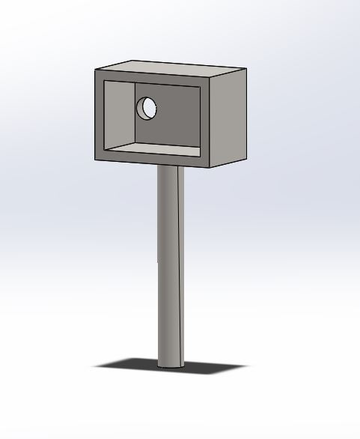
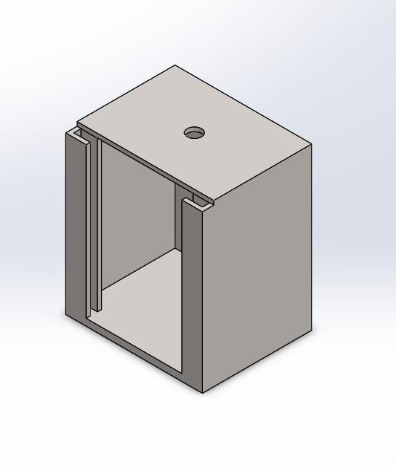
Sensor Mounting
LiDAR Sensor Mount
Improvements made upon previous year's design to address multiple issues including:
Slipping between the servo motor and LiDAR sensor mount when turning the sensor to scan
Insufficient mount strength for the servo motor to prevent over torque
Fix temporary attachment solutions that included Velcro patches
Left options open for additional mounts as needed for the expanded sensor suite...
Camera Mount
Notes:
Wilson

Slide 21
Computing Team
Bridge between sensors and controls
Taking information from sensors onboard and turning that into data that can be used in order to control the ASV
State Diagram
Understand what inputs are needed for controller to get intended outputs
Hardware and Software
Understand the needs for the vessel in order to best complete Roboboat objectives
Notes:
Sam

Slide 22
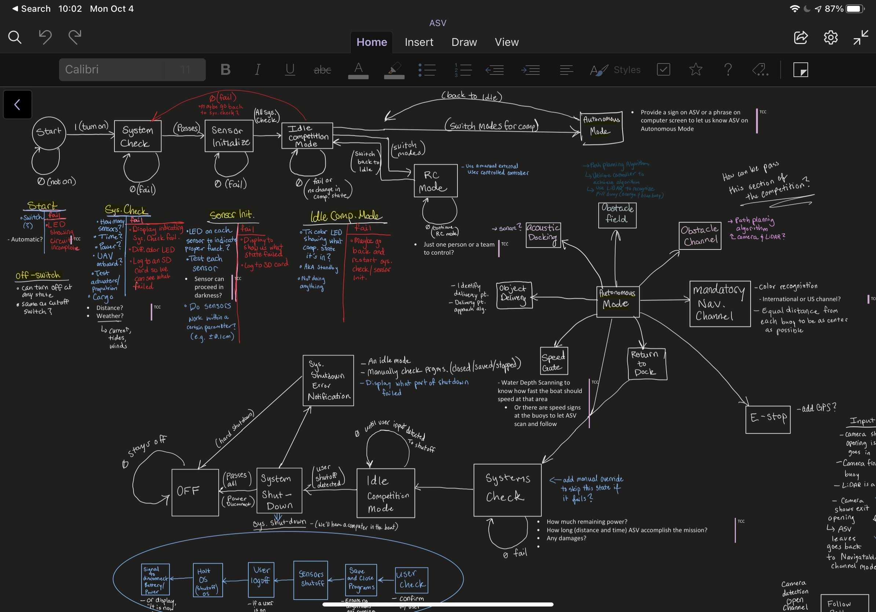
Our State Diagram
Notes:
Sam

Slide 23
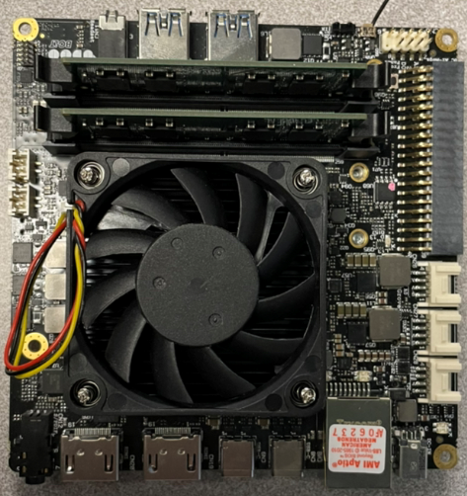
Computing Design Choices
Have a single board inside the ASV
UDOO BOLT V8 – the ASV's onboard computer
OS system on our computer
Linux Ubuntu 20.04 LTS
Programming Language: Python 3.9.7
Notes:
Tann

Slide 24
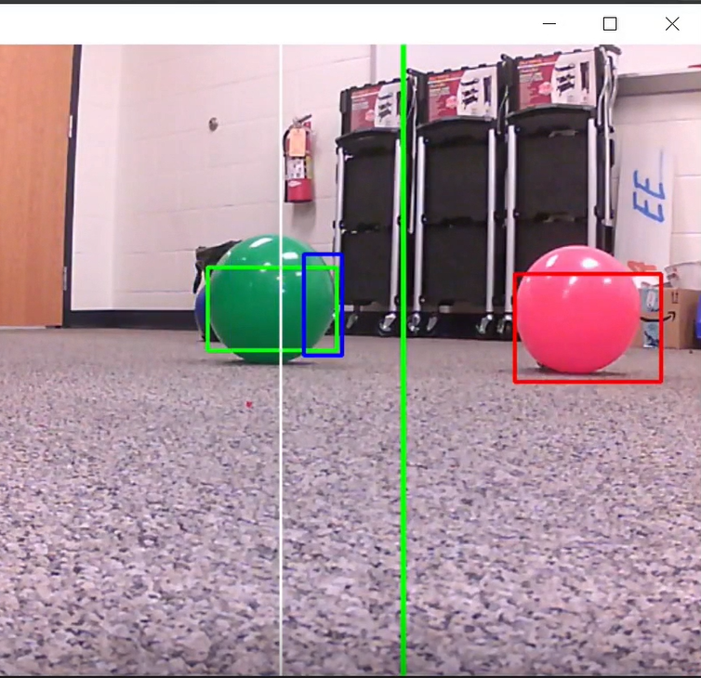
Current Complications/Struggles
Using last year’s code
Doesn’t meet our current year’s requirements and needs
Poor detection of buoys when outdoors under sunlight
Solutions:
Create a better code that meets our needs
Test a range of RGB values that the camera can pick up under sunlight and narrow the upper and lower limits in our code
Notes:
Sam

Slide 25
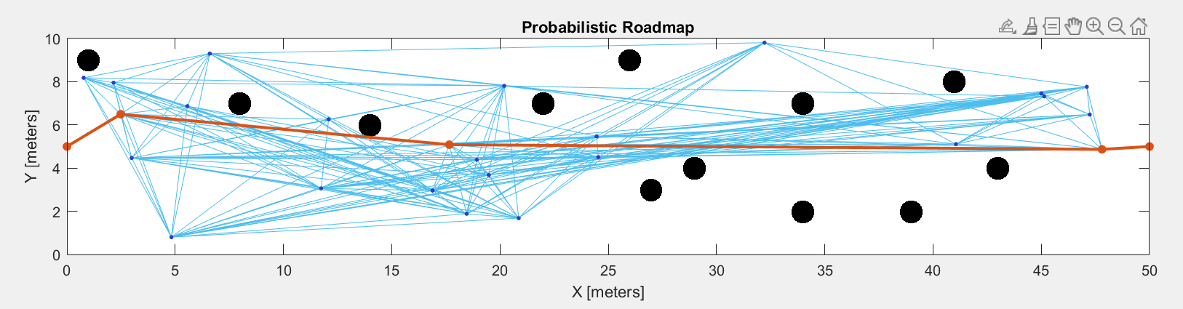
New Path Finding Algorithm
Utilize Image from UAV team to generate a path
Plot buoys as points
Generate path through field
Communicate with Controller
Notes:
Connor

Slide 26
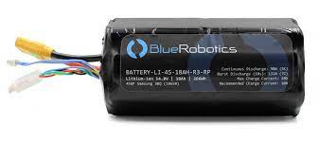
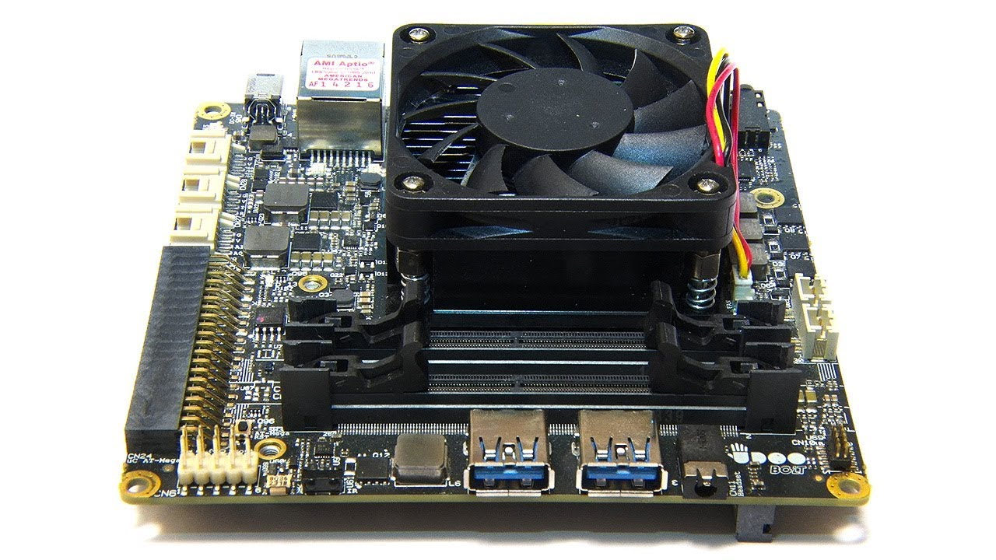
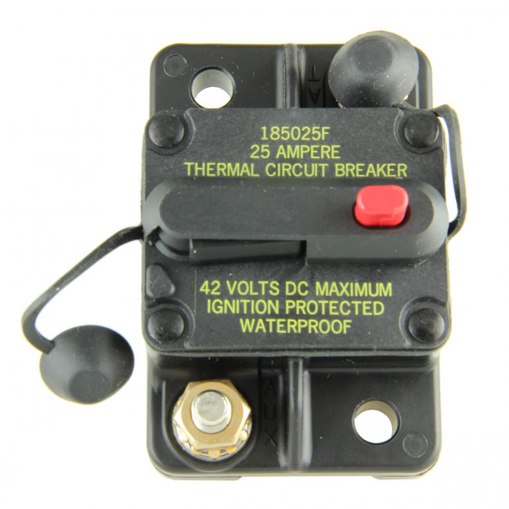
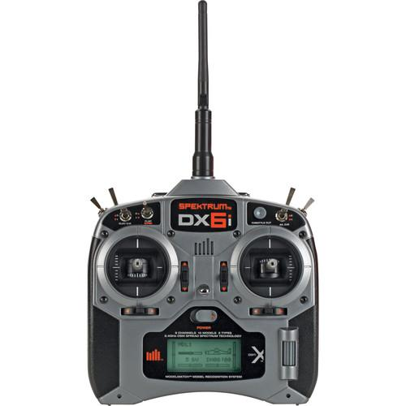
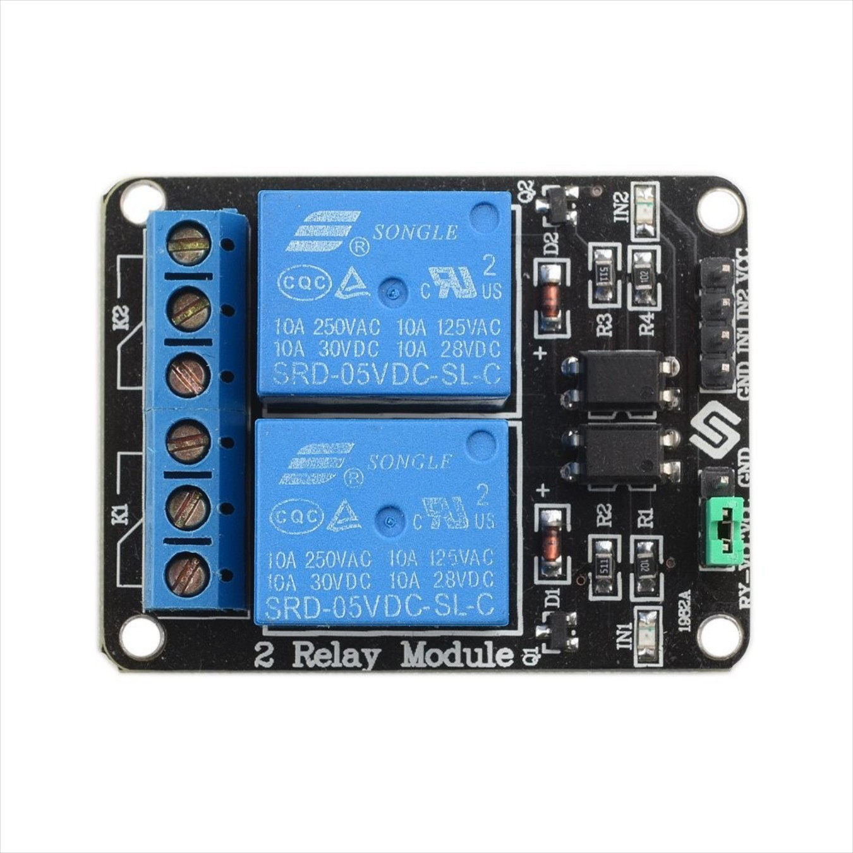
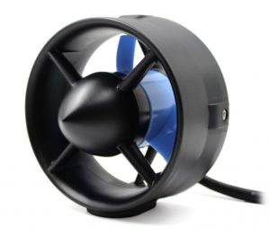
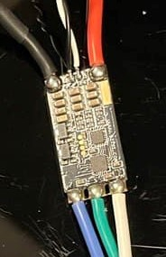
Components in Power Systems
1. Batteries
2. Circuit Breakers
3. Relay Module
4. Electronic Speed Controllers (ESC)
4. UDOO Bolt
5. AR610 RF Receiver
6. T200 Thrusters

Slide 27
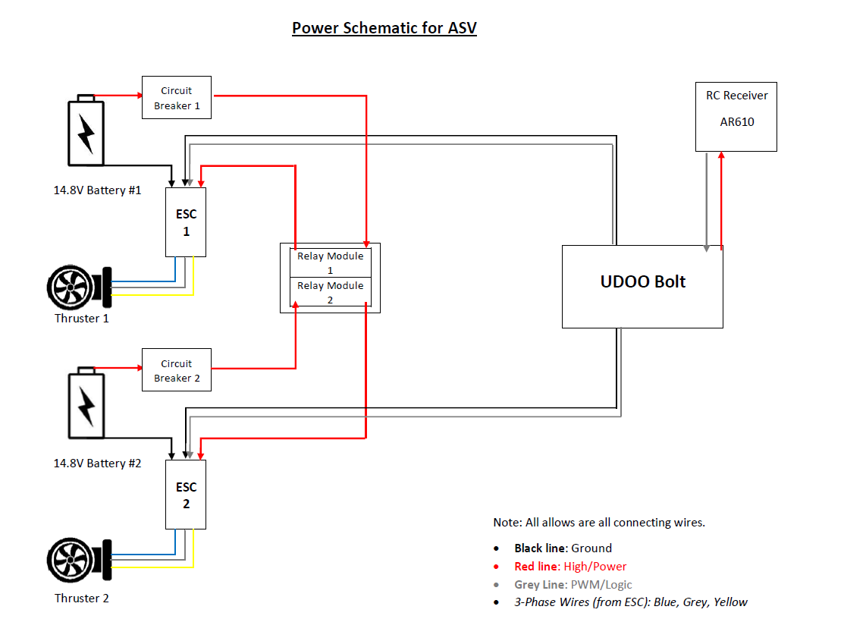
Notes:
Tann

Slide 28
Future Plans - Short Term
Late October 2021: Test the ASV in the Thames River with a simplified sensor suite onboard
Determine exact maneuverability of the vessel, vessel reaction time to thruster inputs, sensor accuracy/reliability
Obtain a heading for our controller via a GPS
Purchase & mount other necessary sensors
Develop and refine code for both the object/color detection via the camera, and the LiDAR sensor used for navigation and course-keeping
Notes:
Ryan

Slide 29
Future Plans – Long Term
Design a low friction "Bowl" shaped UAV LZ
Design the LZ with a high color contrast to allow easier recovery
Utilize images from the UAV to create a top-down path with the path finding algorithm
Notes:
Sam

Slide 30

Questions?

